Slide 1


Inferring Drivers of Cholera Transmission from Historical Data
Matthew Phelps

Slide 2
Objectives
Rationale
Uncertainty of cholera transmission pathways still exists and is difficult to infer
High quality data from 1853 Copenhagen outbreak can potentially provide information on transmission pathways
Evaluate the degree to which water-borne transmission routes drove the Copenhagen cholera outbreak of 1853, relative to non-water-borne transmission routes
Methodology
Construct spatially-explicit discrete-time models of Copenhagen outbreak
Select most appropriate model using Deviance-Information Criteria

Slide 3
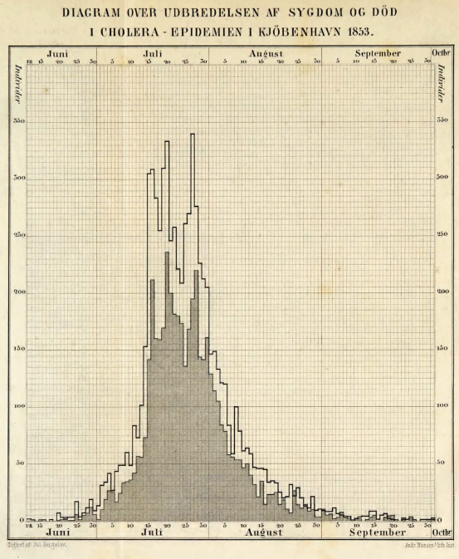

Slide 4
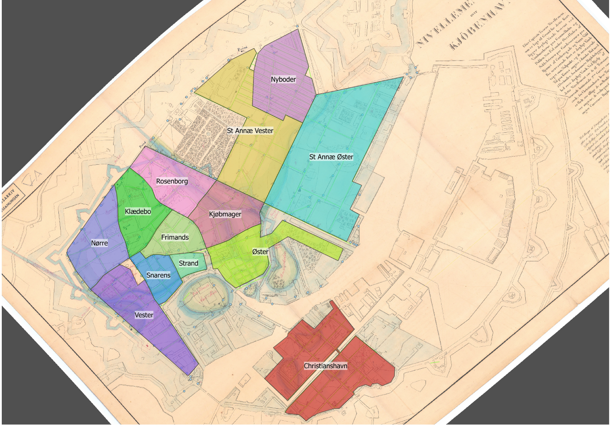

Slide 5
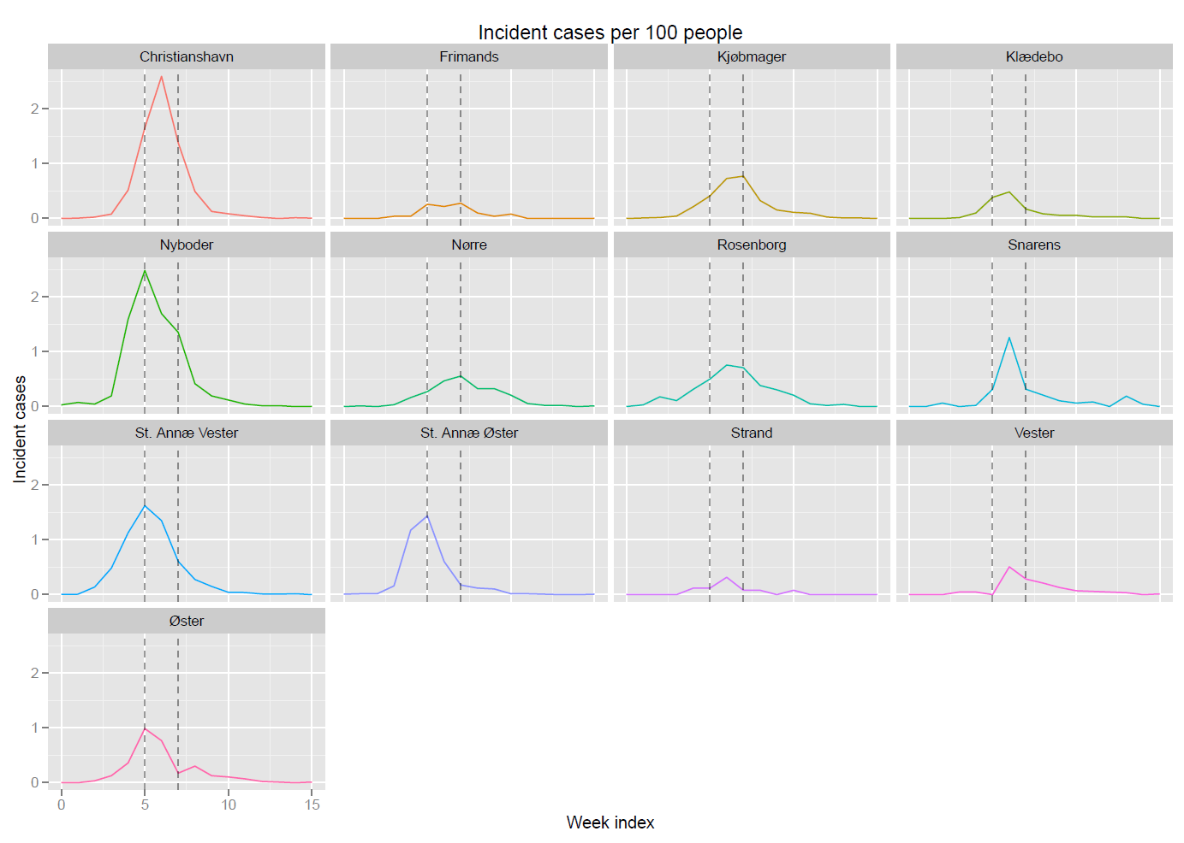

Slide 6
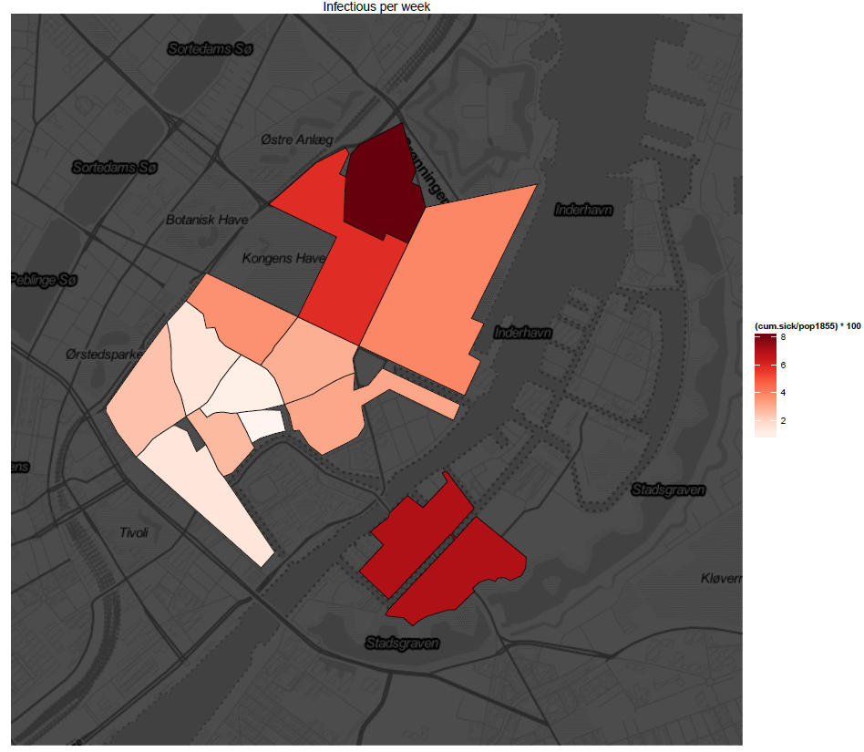
Cumulative infections

Slide 7
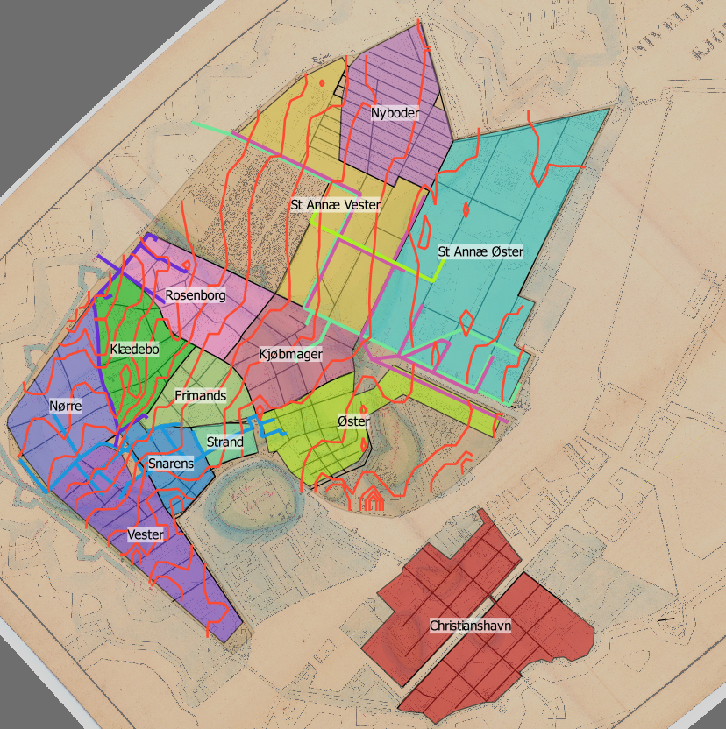
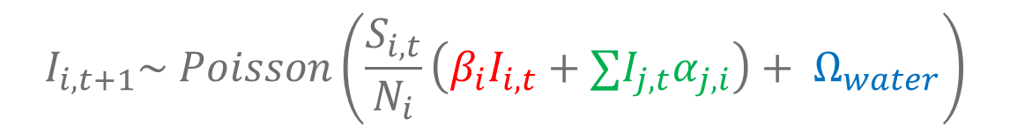
$$I_{i,t+1}\sim Poisson\left(\frac{S_{i,t}}{N_{i}}\left(β_{i}I_{i,t}+∑I_{j,t}α_{j,i}\right)+ Ω_{water}\right)$$

Slide 8
Funding
Changing Disasters 2016 KU Project
Collaborators
Lone Simonsen – University of Copenhagen Global Health Section
Ginny Pitzer – Yale University
Viggo Andreasen – Roskilde University
Thomas Alexander Gerds – University of Copenhagen Biostatistics Section

Slide 9
Dynamic Compartmental Model of Yaws Elimination among Baka Communities in DRC
Currently >65,000 incident cases worldwide
One-time dose of oral antibiotic sufficient treatment (2012)
WHO Targeted yaws for eradication by 2020 via MDA programs
MDA programs for eradication never been modeled
Our model tests 510 treatment scenarios
Results indicate WHO guidelines too optimistic

Slide 10
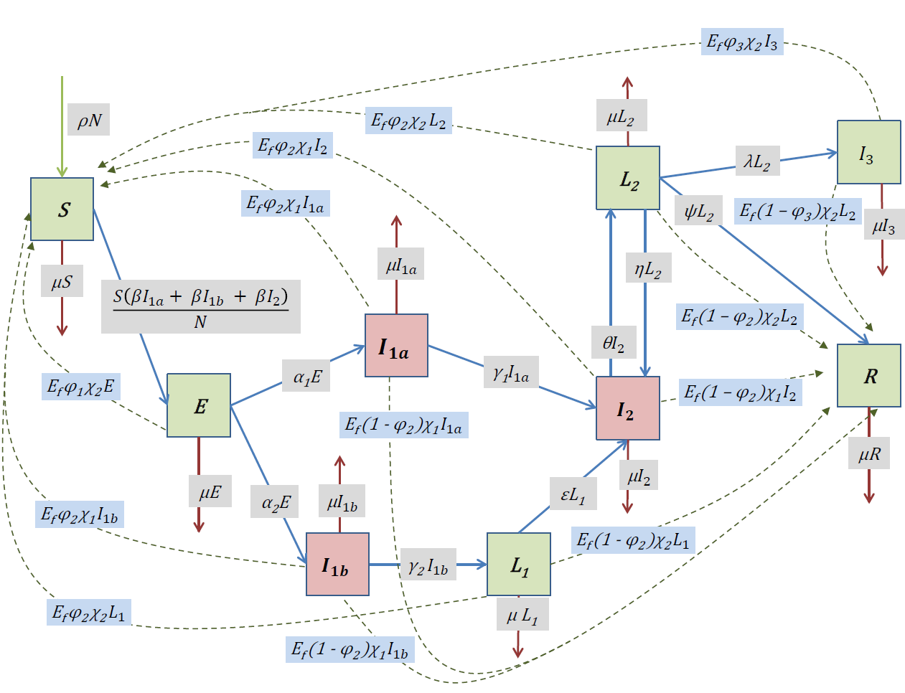

Slide 11
